Slide 1
MOVIE TICKET BOOKING
& REVENUE ANALYSIS
SQL Database Project | Beginner to Medium
Presented by: __________________

Slide 2
1. Project Overview
Why this database is useful
A cinema needs to track movies, screens, showtimes, seats, bookings and payments.
The database stores these details in connected tables instead of one large table.
SQL queries turn booking records into useful business reports.
Level: Beginner → Medium | Database: MySQL 8.0+

Slide 3
2. Objectives
Identify the highest-grossing movies.
Calculate seat occupancy for each showtime.
Compare weekday revenue with weekend revenue.
Measure cancellations and cancellation percentage.
Track booking trends by date and compare revenue by city/payment method.

Slide 4
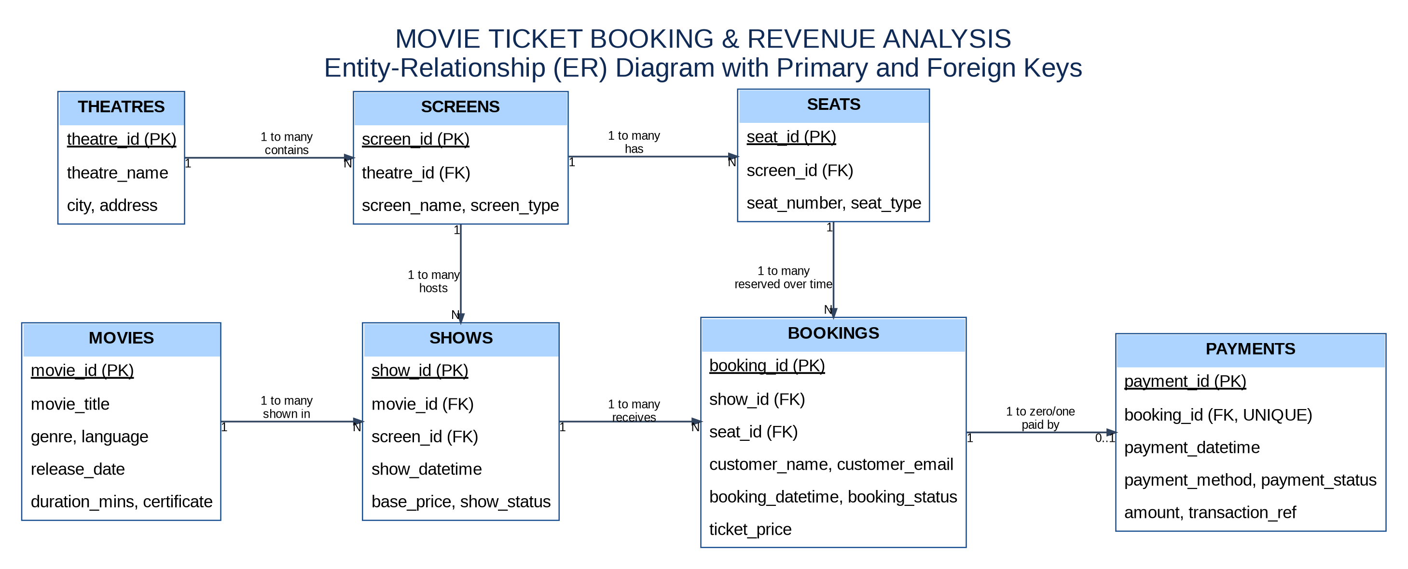
3. ER Diagram
Primary keys (PK) identify rows; foreign keys (FK) connect tables

Slide 5
4. Database Design
Seven main tables
Movies — movie information. Theatres — cinema locations.
Screens — screens inside theatres. Seats — seats inside screens.
Shows — movie + screen + date/time + base price.
Bookings — one ticket/seat for one show, including booking status.
Payments — payment method, amount and payment status.
Relationships use primary keys and foreign keys; a unique rule stops duplicate booking of one seat for the same show.

Slide 6
5. SQL Concepts Used
CREATE DATABASE / CREATE TABLE — build the database.
PRIMARY KEY / FOREIGN KEY — identify and connect records.
JOIN — combine related table data.
SUM, COUNT, CASE, GROUP BY, HAVING and ORDER BY — calculate and compare results.
Views save common reports; indexes can improve lookup speed.

Slide 7
6. Analysis Reports
Movie revenue: add successful payments for valid bookings and rank movies.
Seat occupancy: valid occupied seats ÷ total seats × 100.
Weekday/weekend: classify the show date, then sum valid revenue.
Cancellations: count cancelled bookings and calculate their percentage.
Booking trends: count bookings by booking date.

Slide 8
7. Business Rules & Assumptions
Each booking row represents one seat for one show.
A seat can be booked again for another show, but not twice for the same show.
Only Successful payments from Confirmed/Completed bookings count as revenue.
Cancelled bookings are excluded from occupancy and revenue.
Sample data is created for learning; it does not represent real cinema performance.

Slide 9
8. Conclusion
The project demonstrates relational database design with seven connected tables.
SQL reports help compare movie performance, seat usage, cancellations and revenue trends.
The design can be extended with customers, multiple payment attempts, refunds and online booking integration.
Thank you | Questions?

